Slide 1
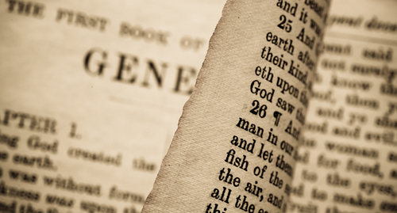
In The Beginning:
THE FAMILY
Genesis 1:26 – 2:25
part 1

Slide 2
Why Does
Mankind Marry?
Because Man Is CREATED in God’s Image
Because Man Is NOT an ANIMAL

Slide 3
Genesis 1:26-28
26 Then God said, "Let Us make man in Our image, according to Our likeness; let them have dominion over the fish of the sea, over the birds of the air, and over the cattle, over all the earth and over every creeping thing that creeps on the earth."
27 So God created man in His own image; in the image of God He created him; male and female He created them.
28 Then God blessed them, and God said to them, "Be fruitful and multiply; fill the earth and subdue it; have dominion over the fish of the sea, over the birds of the air, and over every living thing that moves on the earth."

Slide 4
3 Differences Between Man And Animals
(Gen. 1:26-28)
Man, as a kind, was created in the image and likeness of God

Slide 5
Man’s Composition
A Three Part Masterpiece
  A body framed from the earth
    Genesis 2:7; Ps. 103:14; Ecclesiastes 3:20
  A body that is living and mobile
    Genesis 2:7; Acts 17:25-28
  A body that houses a spirit
    Hebrews 12:9; Zechariah 12:1;
    Ecclesiastes 12:7; James 2:26
Shared With Animals
Gen. 7:15
Unique to Man
Makes him an intellectual, accountable, and moral agent!
Eccl. 12:13, 14; 2 Cor. 5:10

Slide 6
3 Differences Between Man And Animals
(Gen. 1:26-28)
Man, as a kind, was created in the image and likeness of God
Man, as a kind, was made to rule over creation
  Psalm 8:4-9
  Genesis 2:15
Man, as a kind, was created “male and female” for superior reasons—to grow a family
  Not merely to “keep the species alive,” but also to subdue the earth (Gen. 7:3)
  To produce emotional, physical, and spiritual development (Ps. 127:3-5; Mal. 2:15; Is. 38:19; Eph. 6:4)

